Slide 1
Keeping our patients safe: Assurance on oxygen demand and capacity
Phil Deady, Director of Pharmacy & Chair Medical Gases Committee, MYHT
Andy Carr, Head of Estates, MYHT
John McLachlan, Engineering Manager, Engie
National Medical Oxygen Webinar, 27th Nov 2020
Medicines Optimisation & Pharmacy Services
helping you use medicines well

Slide 2
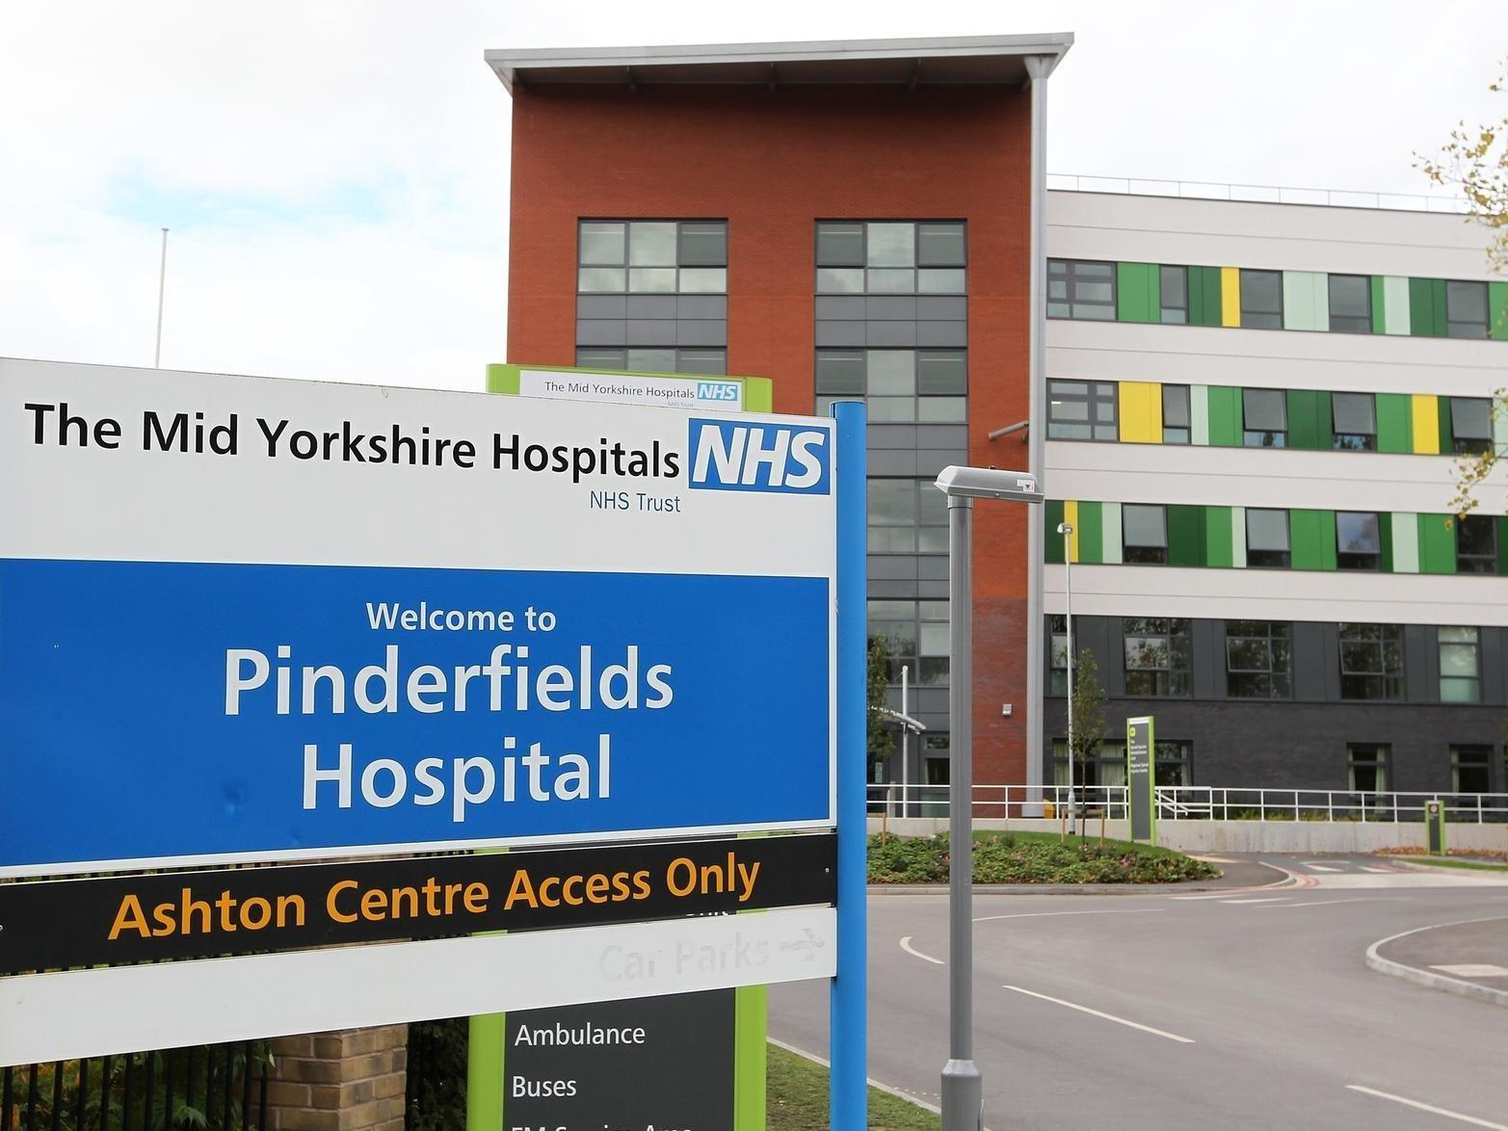
Pinderfields Hospital, Wakefield
Opened June 2010
~ 700 beds
“Hot” site for MYHT
PFI
Critical care units (intensive care and acute respiratory care) are only at Pinderfields Hospital

Slide 3
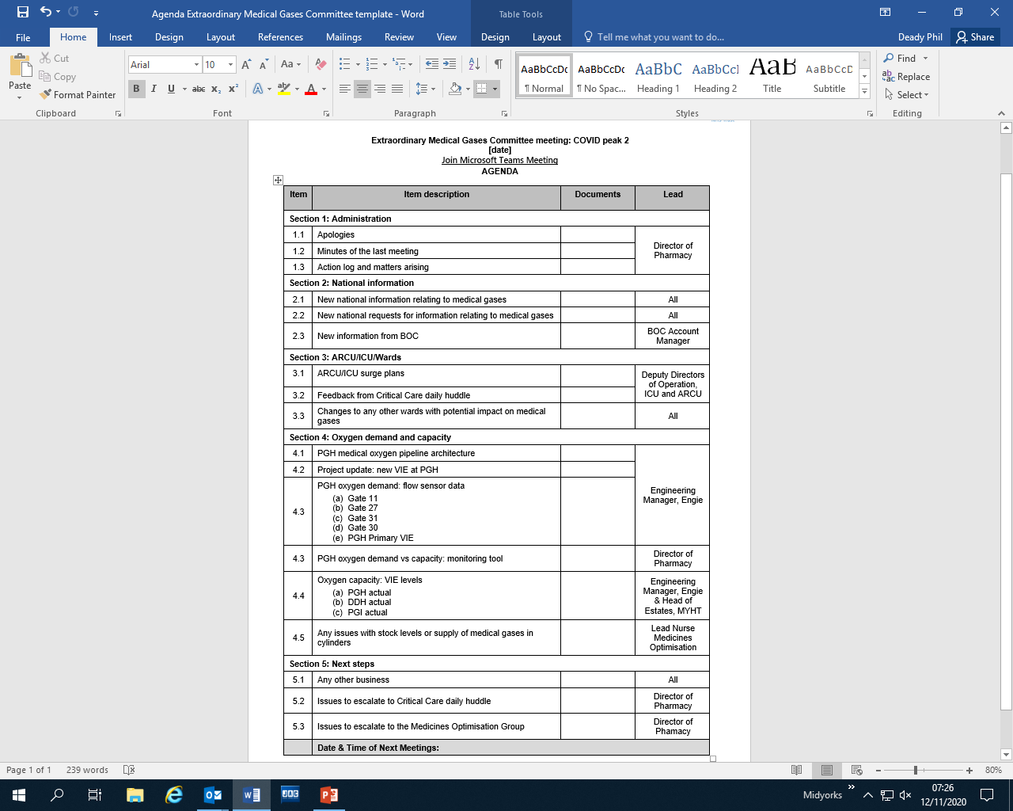
Medical Gases Committee leadership on oxygen demand and capacity
Weekly meetings during COVID-19 pandemic peaks
Chaired by the Director of Pharmacy
Reports to the Medicines Optimisation Group, chaired by the Medical Director
Feeds into and back from the daily Critical Care huddle, and daily Executive COVID huddle (Director of Pharmacy is a member of both)
Multidisciplinary membership including ICU and ARCU Consultants, Nurses, Deputy Directors of Operations, Estates, Facilities, Medical Physics, Supplies, Risk Management, and Pharmacy
Reviewing national information, acting on patient safety alerts and field safety notices, learning from other Trusts

Slide 4
Engagement with critical care medical and nursing teams and leadership on oxygen demand and capacity
Pro-actively involved in planning the safe management and monitoring of oxygen demand and capacity throughout the COVID-19 pandemic
Oxygen demand and capacity was (and continues to be) a vital factor when planning critical care surge capacity, both in peak 1 and peak 2 of COVID-19
Consultants in intensive care and acute respiratory care and their medical teams fully sighted on oxygen demand and capacity on a daily basis
ICU and ARCU Consultants reviewing patients each day in the Emergency Department have a real-time understanding of oxygen capacity for patients on each of the ICU and ARCU surge wards to aid decision making on patient flow from ED
Any oxygen demand considered to be wasteful reviewed and stopped (eg. HCA NIV checks during patient mealtimes)
Recent audit of oxygen demand at PGH (09/11/2020) showed:
  Average O2 demand across all patients receiving O2 by any method: 15 L/min/patient
  Average O2 demand across all ARCU patients only: 31 L/min/patient
  Average O2 demand across all ICU patients only: 29 L/min/patient

Slide 5
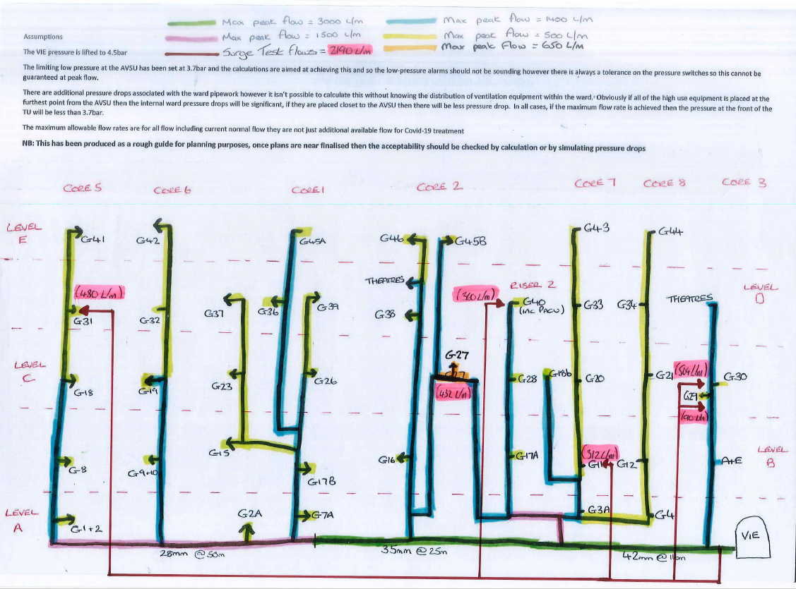
PGH oxygen pipeline architecture
PGH oxygen pipeline architecture well-known to all key stakeholders, including Executives
Modifications made to ensure that identified oxygen demand from planned surge wards are achievable
Load testing completed on all planned surge wards to provide assurance on safe oxygen demand and capacity
Primary and new secondary emergency manifolds upgraded to provide 3000L/min oxygen in the event that the primary and secondary VIEs fail
Flexim real-time oxygen flow meters installed to all critical care surge wards and the primary VIE, with alarms linked to the estates business management system, manned 24/7
Daily checks of VIE telemetry
Future plans: ring main installation; second primary VIE installation on the PGH site

Slide 6
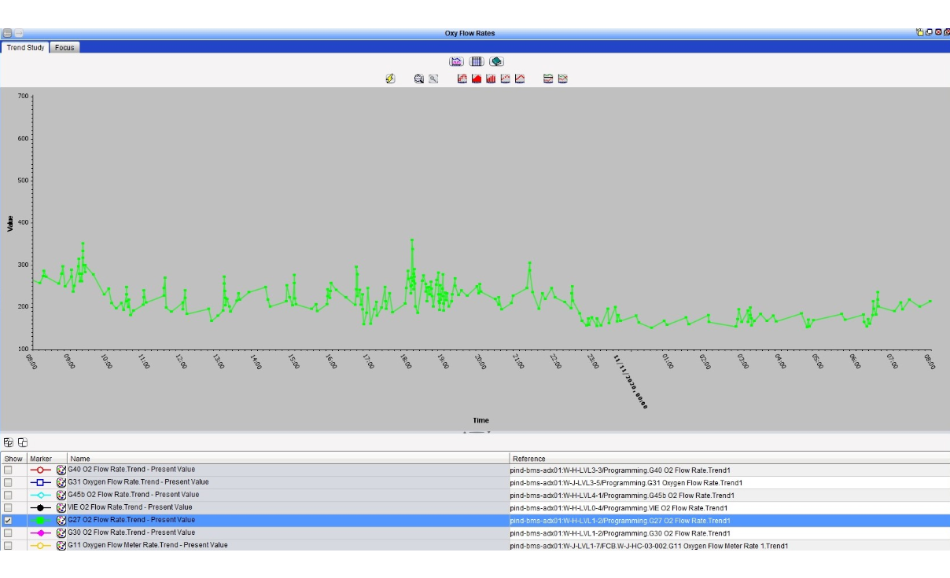
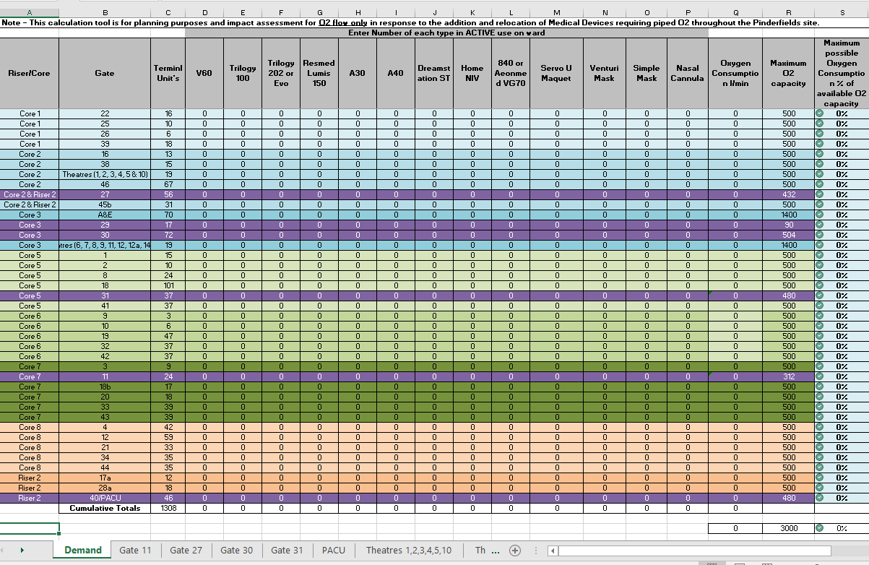
Monitoring and reporting oxygen demand and capacity
Real-time oxygen flow sensor trends reported from the building management system
Shared with and reviewed by the Medical Gases Committee and Critical Care huddle daily, including weekends
Used in situ in real time by ICU and ARCU clinical teams
Any demand over safe set limits triggers an alarm, managed 24/7 by Engie who speak with the ward manager to agree corrective action if needed as per standard procedure
Twice daily manual audits of ICU and ARCU patients’ oxygen demands
Weekly manual audits of all non-critical care PGH inpatients’ oxygen demand eg. mask/nasal

