Slide 1
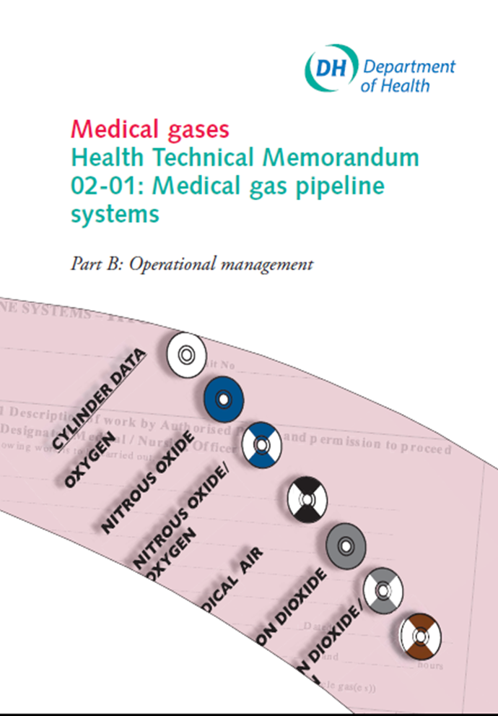
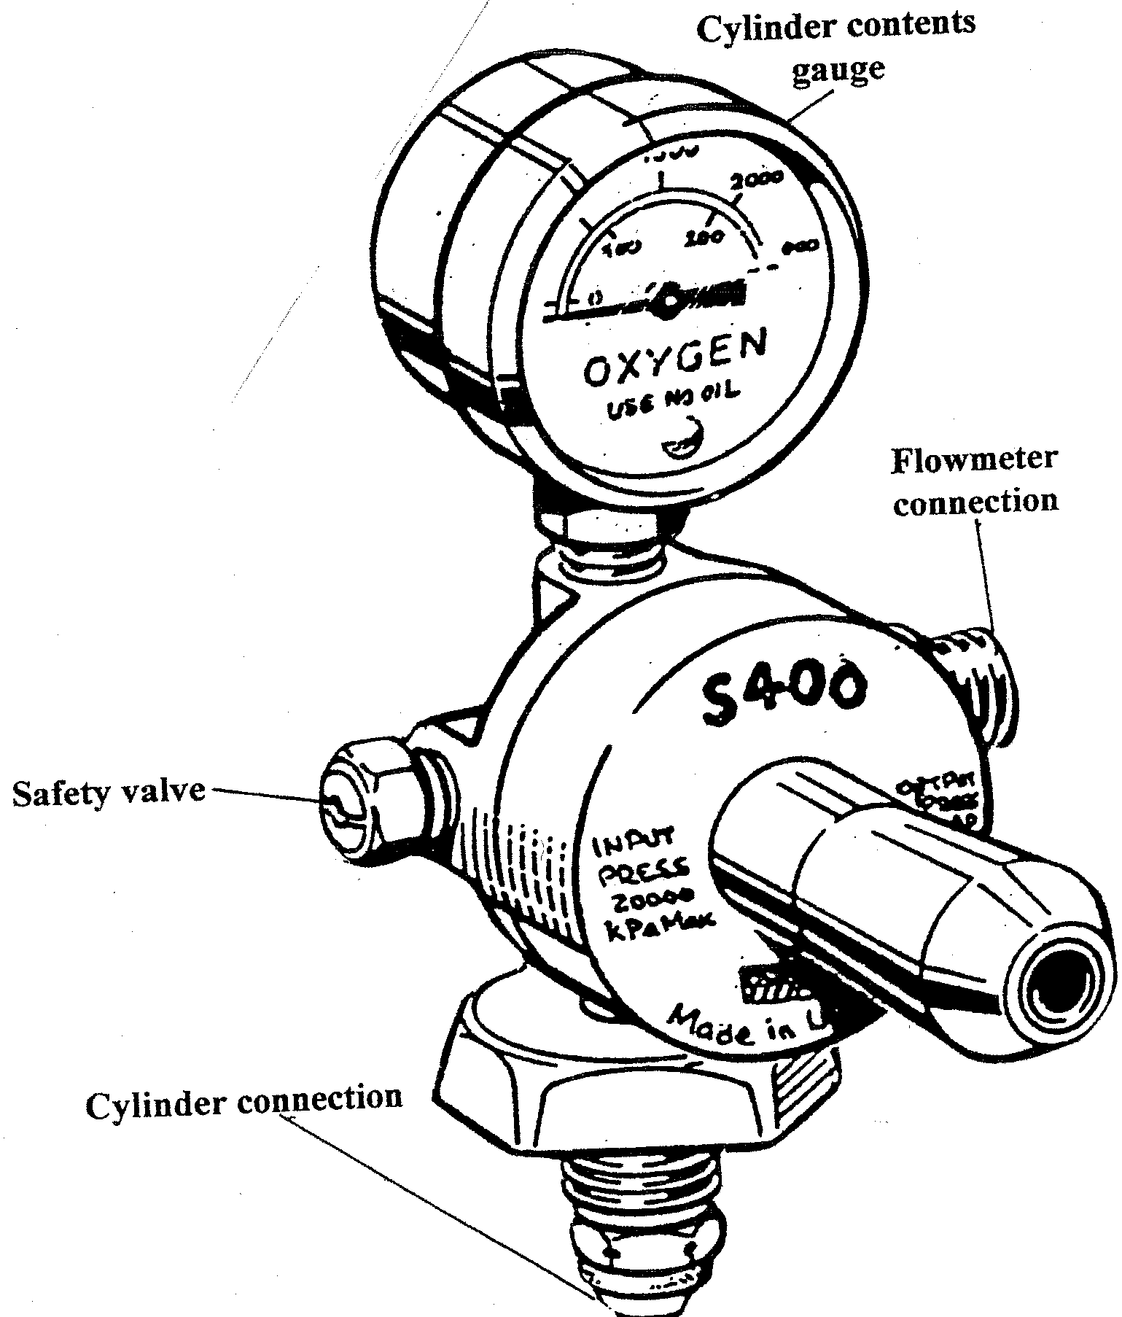
Gas Cylinder Management – a few other things to worry about?
Rob Lowe QA Specialist Pharmacist East of England

Slide 2
Fires
Fire caused by a faulty oxygen cylinder in the ICU at Royal United Hospital Bath in 2013. The patient was self ventilating receiving piped oxygen via a facemask and was being readied for transfer from the unit. A CD size oxygen cylinder was placed on a patient’s bed. Due to a valve fault the cylinder valve ignited when the regulator was opened and four-foot flames shot from the valve end of the cylinder. The fire spread rapidly to the bed linen, mattress, curtains and ceiling tiles, and the ICU began to fill rapidly with thick, black, acrid smoke.
The patient on whose bed the oxygen cylinder lay suffered burns to her lower limbs, and was stabilised and transferred to the tertiary burns centre.
This is a rare occurrence; normally fires start due to stupidity.

Slide 3
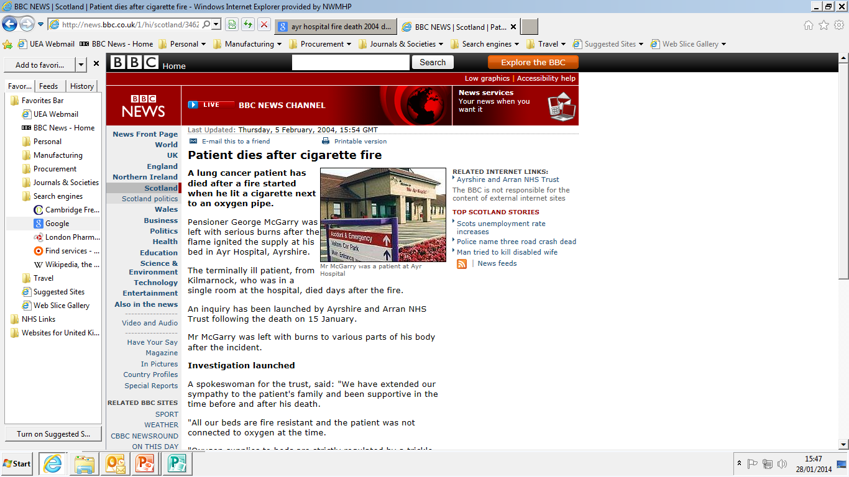

Slide 4
Fires
DH figures from 2004/5 show 224 fires across the NHS as a whole were started by smoking. Anecdotal evidence suggests the smoking ban initially exacerbated the problem by driving smokers into out of the way areas for a crafty fag.
1994 Ruchill Hospital Glasgow. Patient dies in flash fire caused after he removed his oxygen mask to light up.
2002 Warrington General Hospital. Surgical ward gutted and 90 patients evacuated after accidental fire started by cigarette.
2008 Glasgow. Patient miraculously suffers only minor burns after setting his oxygen nasal cannula set alight while smoking.

Slide 5
Fires – Other Problems
Removal of oxygen face mask and placing it on the bedding or pillow wastes medical gas, reduces treatment effectiveness and saturates bedding with oxygen making it highly flammable – resuscitation fires from defibrillator
Hoarding of cylinders in ward storage cupboards etc. (when piped oxygen is available) is storing up problems in case of a fire.

Slide 6
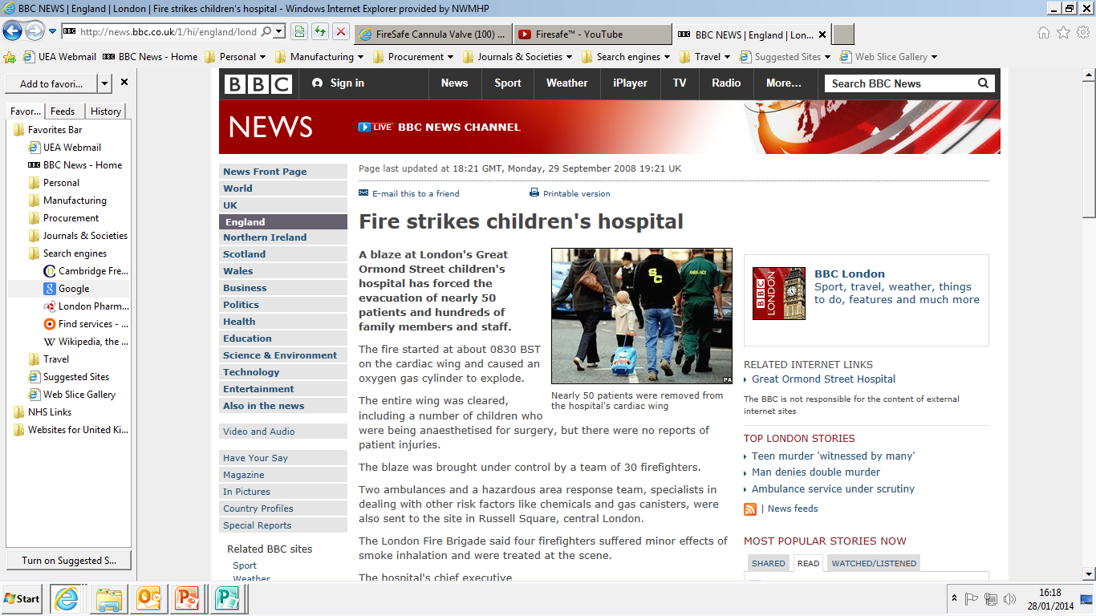

Slide 7
Wastage of Medical Gases
Cylinders are used when piped gas is available, which is much cheaper. Note the price of gas per unit volume increases as cylinder size decreases.
Flowmeters left open on piped gas supply. Aside from the fire risk in the case of oxygen, there is a cost associated with this wastage. A survey of piped gas usage in Colchester General Hospital in 2006 found piped oxygen being wasted at a rate of 102L/min.
While that doesn’t sound much it adds up to 146,880L/day or 16% of the total daily usage of piped oxygen at that time at Colchester. Put another way this was 1 day’s supply of oxygen per week wasted.

Slide 8
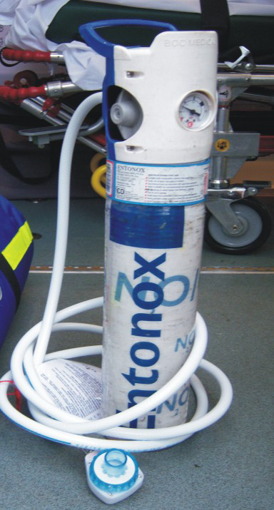
Cylinder Storage Issues - Entonox®
Entonox® is a 50/50 mix of nitrous oxide and oxygen combined in the same high pressure cylinder.
This does have a bearing on the storage requirements for Entonox® as the two gases will start to separate out at low temperatures (below 4°C).
Entonox® cylinders should be maintained at a temperature above 10°C for at least 24 hours before use (and if D size or smaller stored horizontally). Remixing of the 2 gases can be achieved after warming the cylinders if they are subjected to cold temperatures.

Slide 9
Cylinder Storage Issues - Entonox®
Are Entonox® cylinder storage areas in your trust heated?
There have also been increasing reports of theft of cylinders for nefarious partying purposes. How secure is your cylinder store?

Slide 10
Cylinder Storage Issues - Safety
On a building site 80 Argonite® cylinders, (about the same dimensions as J sized medical gas cylinder) were waiting to be attached to a fire suppression system. They were stored upright without the protective caps over the valve assemblies being in place and were not secured in racks or by any other means. Something caused one or more of these cylinders to fall over. On hitting the concrete floor the unprotected valve sheared off releasing a jet of liquefied gas at 300 bar pressure.
This caused the cylinders to take off (literally) and hit other cylinders causing them to fall and lose their valves. A chain reaction developed rapidly and lasted for several minutes until 66 of the 80 cylinders had discharged. It is estimated that some cylinders achieved speeds of 170 mph and had sufficient energy to penetrate walls and ceiling voids, travelling to more remote parts of the building site.

Slide 11
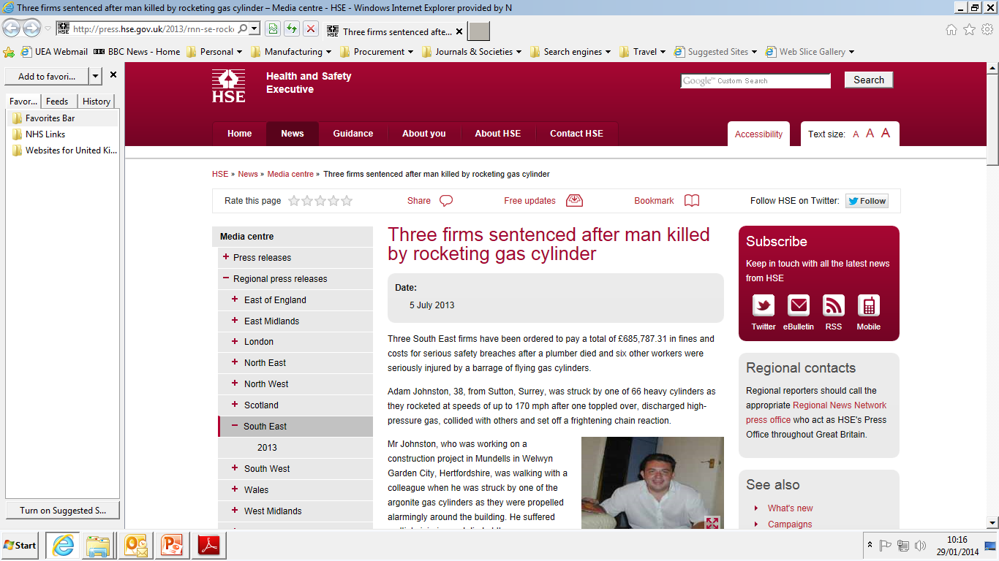
Cylinder Storage Issues - Safety

Slide 12
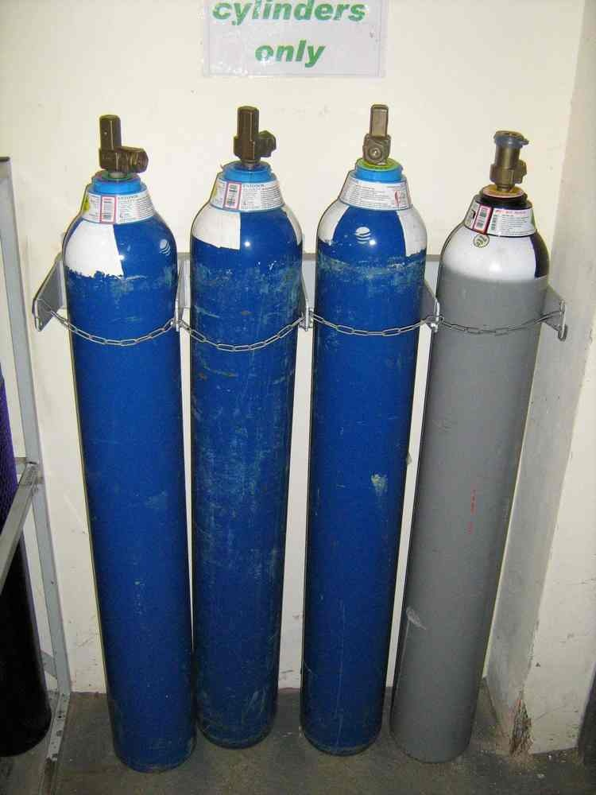
Cylinder Storage Issues - Safety
Are cylinders securely stored and transported in your trust?
Even if a valve doesn’t sheer off if a cylinder topples or is dropped on the floor, you don’t want it to land on a patient’s, nurse’s or porter’s foot.

Slide 13
And Finally…..
The Royal Victoria Infirmary, Newcastle, November 2013

Slide 14
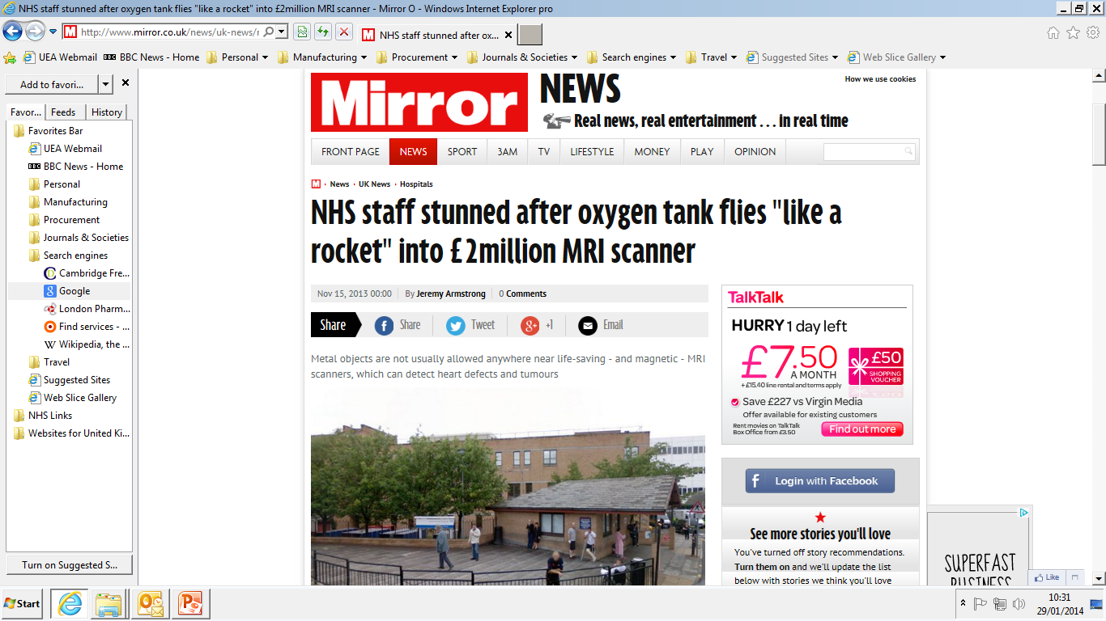

Slide 15
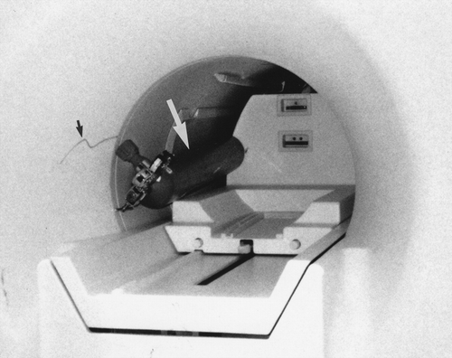

Slide 16
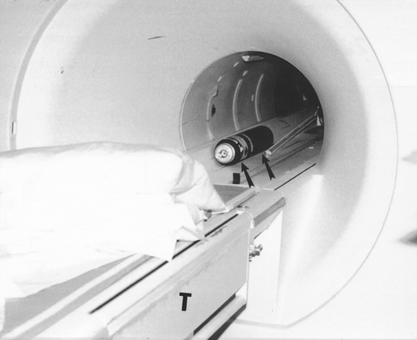

Slide 17
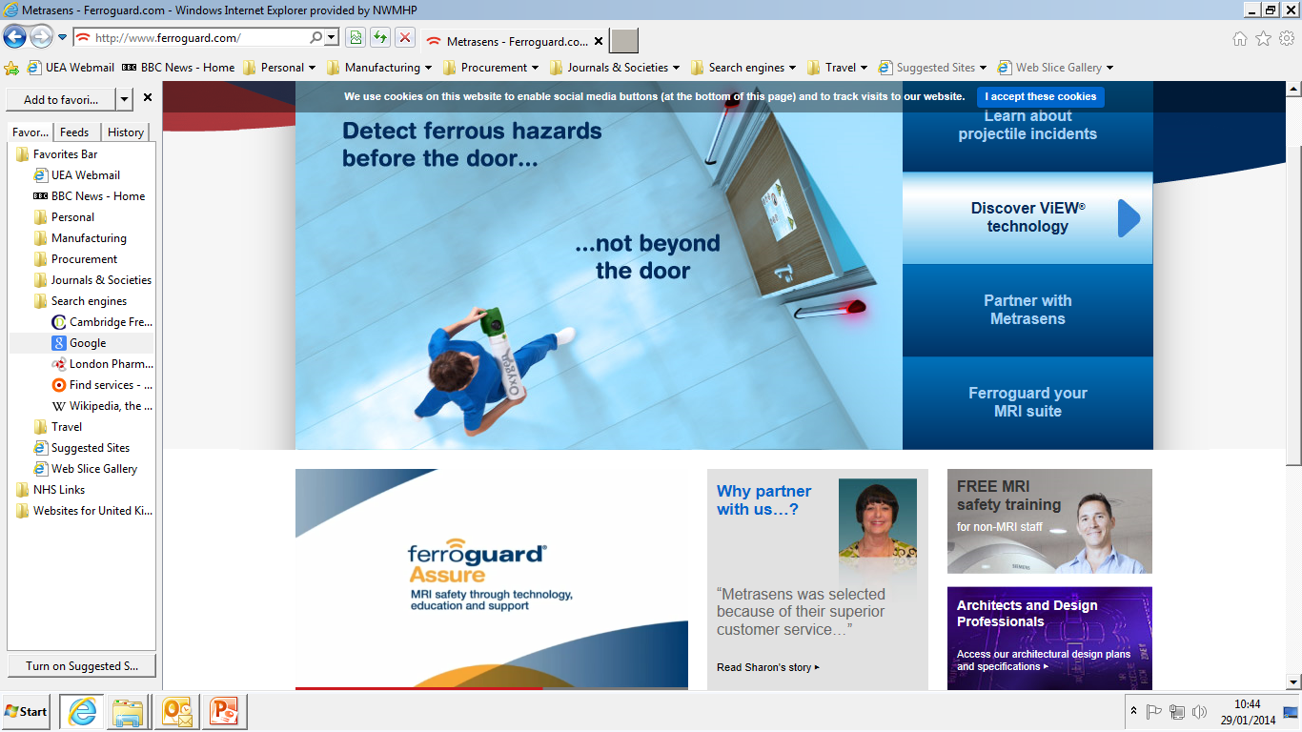

Slide 18
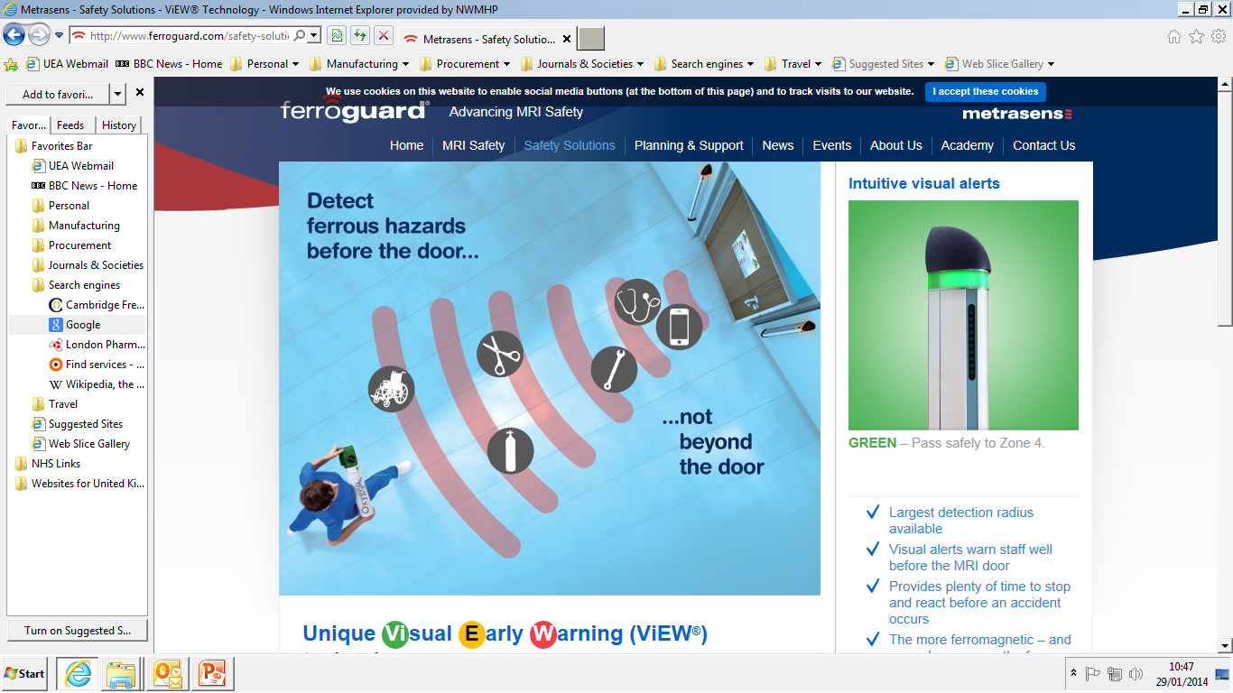

Slide 20
Costs associated with MRI Accidents
The costs associated with such an MRI accident irrespective of any liability for injury or death to a patient or staff member can be variable and expensive. Typical costs can include all or a combination of the following elements;
Displacement of the gradient coil—up to £15,000.
Replacement of the scanning table—up to £8,000.
Refilling the scanner with helium—up to £10,000.
Replacement service on an emergency hire basis—up to £15,000 (approx. cost of £3,000/day).
Typical total cost to trust of up to £48,000 in repair and service charges only.

Slide 21
Aluminium Cylinders
Size | Gas Content (L) | Water Content (L) | Construction
AZ | 170 | 1.2 | Aluminium
ZA | 300 | 1.0 | Aluminium (Carbon fibre hoop wrapped)
CD | 460 | 2.0 | Aluminium (Kevlar hoop wrapped)

